Slide 1
Mobile Phone Prices
Team member
Rupinder Singh
Sharvil gad

Slide 2
Background story
In today’s competitive mobile market, consumers are driven by price, features, and performance. This dataset allows us to explore how key cellphone features like price, camera quality, and battery life impact sales and customer demand.
By analyzing these trends, we aim to uncover what drives consumer preferences, helping guide product development, marketing strategies, and customer targeting. This insight enables brands to better meet market demands and stay ahead in a rapidly changing tech landscape.
Notes:
In these we all use different phones… so in this data we will explore how key feature of phone change its sales and customer demand……. And by analyzing we can see what are the consumer preferences and they are targeting adiences….. And it let them stay it up to date with market…..

Slide 3
Story Summary for the Presentation:
We're analyzing a dataset of cellphone models, focusing on price, camera quality, battery life, and sales.
While budget phones have lower prices, it's the models with premium features—high-end cameras and long battery life—that drive significant sales.
This shows that consumers are willing to pay more for high-quality features, guiding our strategy to focus on optimizing these key specifications to boost sales.

Slide 4
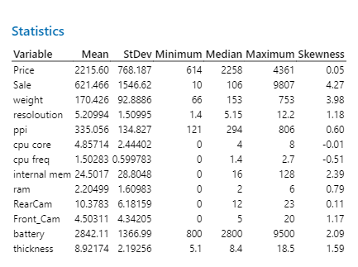
Summary Statistics
Notes:
Most variables have skewed distributions, with some like sales, internal memory, and battery showing strong positive skewness, meaning a few values are much higher than the rest.
Independent variable – price
Dependenty variable - sale

Slide 5
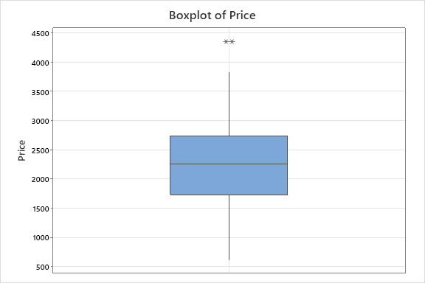
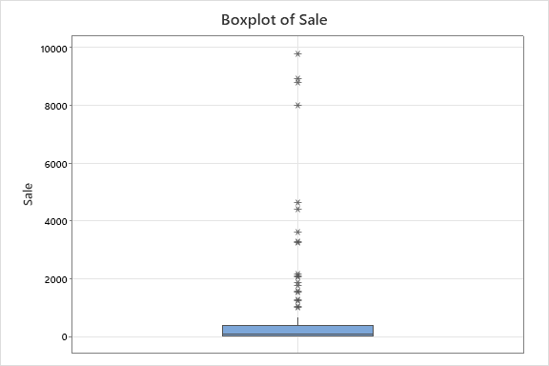
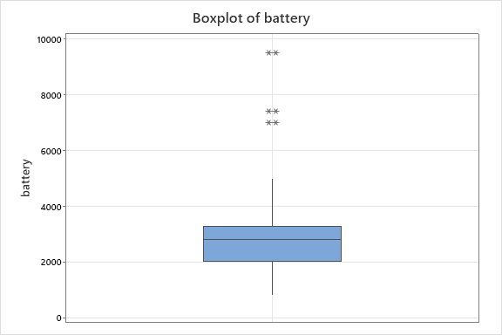
Boxplot of Price, Sale, battery
Notes:
Yo can see these plots which are showing there pricesssss…..

Slide 6
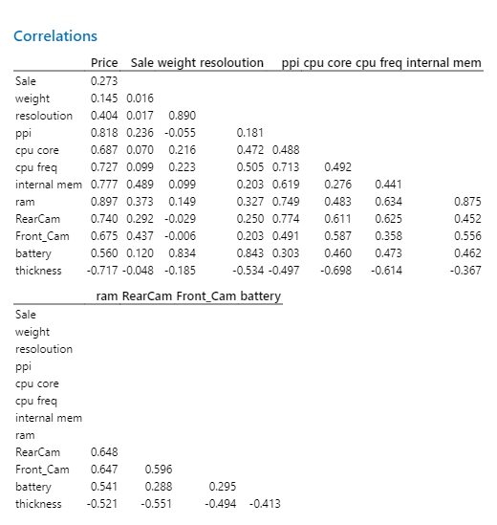
Correlation
Notes:
Ppi - Phone Pixel Density Price has a strong positive correlation with factors like ppi (0.818), RAM (0.897), and internal memory (0.777), indicating that higher-end phones tend to have better displays, more memory, and more powerful components.

Slide 7
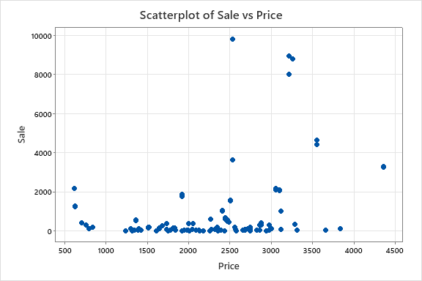
Scatterplot of Sale vs Price
Notes:
The overall pattern appears scattered, indicating no strong linear relationship between price and sale.

Slide 8
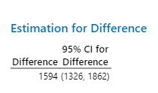
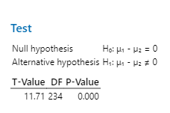
Hypothesis Testing
Notes:
As a company, understanding the relationship between product price and sales is crucial for shaping our pricing strategy and maximizing revenue. There was a need to determine if the difference between the average price of our cellphone models and their corresponding sales numbers was significant.
Since the P-value is less than 0.05, we reject the null hypothesis (H₀: μ₁ - μ₂ = 0), supporting the alternative hypothesis that the means are different.
this would mean there is likely a significant difference between price and sales, and the relationship isn't just due to random chance.

Slide 9
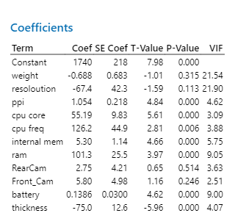
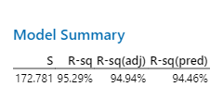
Regression Analysis
Notes:
The output shown provides a regression analysis of mobile phone features and their effect on a dependent variable (likely price or sales). Key insights related to the hypothesis testing are as follows:
Significant variables (with p-values < 0.05) include ppi, cpu core, cpu frequency, internal memory, ram, battery, and thickness. These variables have strong evidence to reject the null hypothesis, meaning they significantly impact the outcome.
For example, ppi (p-value = 0.000) and cpu core (p-value = 0.000) show strong positive impacts on the dependent variable.
Weight, resolution, RearCam, and Front_Cam have p-values > 0.05, indicating that their effects are not statistically significant, and we fail to reject the null hypothesis for these variables.

Slide 10
Recommendations:
Address multicollinearity: Consider removing or combining highly correlated variables like weight and resolution to improve model stability.
Focus on key features: Marketing efforts can highlight features such as display quality (PPI), processing power (CPU), memory, and battery life, as they significantly impact pricing.
Refine the model: Since variables like weight and resolution are not statistically significant, simplifying the model could enhance performance and interpretability.

Slide 11
Thankyou

